Slide 1
Expectation Effect
Michelle Yang

Slide 2
Hello!
I’m Michelle
I’m a psych major
Power of brain ironically overseen
Conscious mind only just a part of who we are

Slide 3
Subconscious is >
Numerous Notable Phenomena:

Slide 4
Halo Effect is a cognitive bias that occurs when an initial positive judgment about a person unconsciously colors the perception of the individual as a whole.
Celebrities- high standing, do no wrong

Slide 5
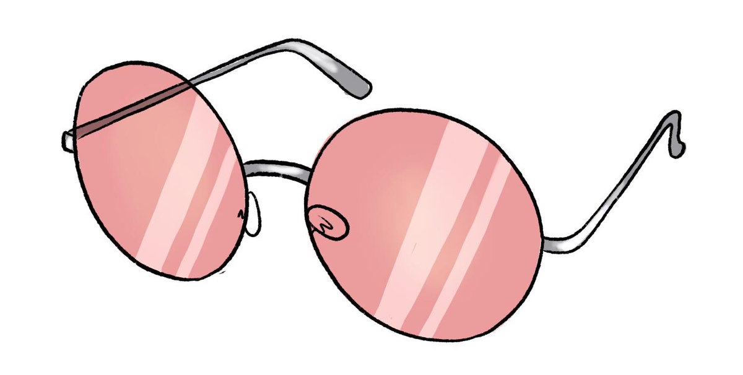
Rose Tinted Glasses
overlook or justify negative traits
preexisting positive trait
Placebo Effect____
medicine and research
experience treatment effects

Slide 6
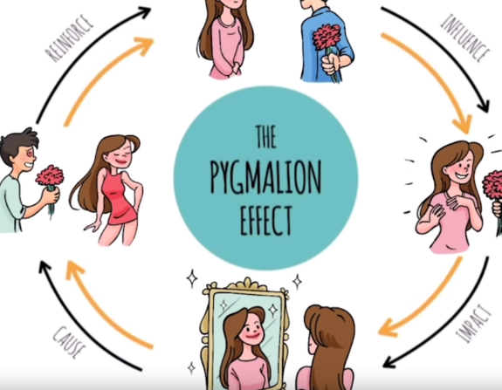
Pygmalion Effect
Self-Fulfilling Prophecy
the expectations of a teacher influence the students’ performance for better or worse
Our Beliefs
Others behavior
Our Behavior
Others beliefs

Slide 7
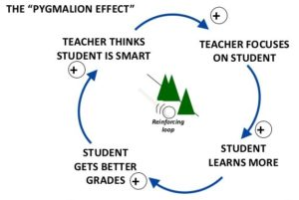
Pygmalion Effect

Slide 8
Hawthorne Effect
(Observer Effect)
“the tendency for people to work harder and perform better due to the attention they receive. More specifically behavior changes by participants during experiments“
Worker productivity increase - employer attention

Slide 9
Demand Characteristic
Experiment- “participants tend to provide responses and act in ways that they believe are expected by the experimenter”
Interviews- behave and speak

Slide 10
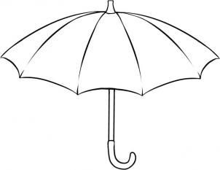
Expectation Effect
“perception and behavior changes based on personal expectations of outcomes”
Design!

Slide 11
The Effects on Design
Negative impact on accurate measure
Bias - unintentional influence
Response- seeking to meet expectations
~Maintain a neutral mindset~

Slide 12
Thanks!
Lidwell, William, et al. Universal Principles of Design. Rockport, 2003.
Borigini , Mark. “The Hawthorne Effect And The Overestimation of Treatment Effectiveness.” Psychology Today, Sussex Publishers, 27 Nov. 2010.
“Halo Effect.” Psychology Today, Sussex Publishers, www.psychologytoday.com/us/basics/the-halo-effect.

